Slide 1
INTEL UNNATI TRAINING PROGRAM
M Vivekandan
Assistant Professor
Department of Artificial Intelligence and Data Science
Rajalakshmi Institute of Technology
vivekandan.m@ritchennai.edu.in
O Pandithurai
Assistant Professor
Department of Computer Science and Engineering
Rajalakshmi Institute of Technology
pandics@ritchennai.edu.in
G Sai Krishnan
Department of Mechanical Engineering
Rajalakshmi Institute of Technology
saikrishnan.g@ritchennai.edu.in
Subramanya Siva S
Artificial Intelligence and Data Science
Rajalakshmi Institute of Technology
Chennai, India
subramanyasiva.s.2021.ad@ritchennai.edu.in
Thaarakenth C P
Artificial Intelligence and Data Science
Rajalakshmi Institute of Technology
Chennai, India
thaarakenth.c.p.2021.ad@ritchennai.edu.in

Slide 2
CONTENTS
Objective
introduction
Concept
Principle
Working
Block diagram
Software implementation
conclusion

Slide 3
OBJECTIVE
To create a deep learning model for conquering fashion mnist dataset.
The model is built and trained with the fashion mnist training data and tested with the validation set.

Slide 4
INTRODUCTION
The fashion MNIST dataset is a popular benchmark for evaluating
the performance of image classification algorithms. CNNs have been
shown to be very effective for image classification tasks, and they
have been used to achieve state-of-the-art results on the fashion
MNIST dataset.
The fashion mnist dataset consists of 60000 training data and 10000 validation dataset.
The study will review existing research and literature on fashion MNIST classification
using CNNs, and it will develop a new CNN model that is able to improve upon the state-of-the-art results.

Slide 5
CONCEPT
The model is developed and has been be trained with the dataset, and its performance is tested with a validation set.
The model is build upon tensor flow using keras library.
The output of the model gives the 2d image which it has classified upon the given input.

Slide 6
PRINCIPLE
The model is been trained with a dataset with which it recognizes the features of the dataset and these features are used to find the similarities in the validation set dataset .

Slide 7
WORKING
1.The model is been created where the datasets are imported from the libraries.
2.Here tensor flow (it is used to work with CNNs) is being used.
3.Keras library is imported which provides an interface for creating ANNs.
4.The next step is where the dataset is being spilt into training set and validation
set.
5.For datavisualization imshow() is used from matplotlib where it gives 2d images
as output.

Slide 8
6.After visualization the convolutional layers are being built, the layers are
mentioned above,each layer having its own function, here 3 convolutional layers
and 3 spooling layers are being built for the hidden layers.
7.After passing the layers the dataset is being flatten using flatten().
8.The program is being compiled for its execution.
9.The number of epochs are being optimized so that the model performs with
accuracy in both training data as well as validation set.
10.The graph is been plotted for the accuracy and error for training and test
results.
11.Final step is where the prediction been made for the given data(label), this
gives the final output.
12.The output is the classified image for the data.

Slide 9
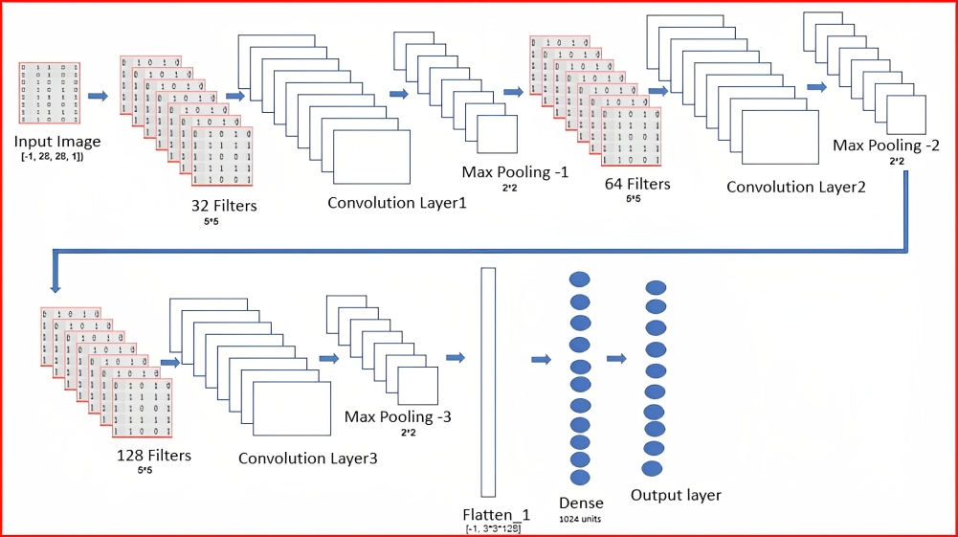
BL0CK DIAGRAM

Slide 10
CONCLUSION
1.The model is built using keras (tensorflow).
2.The dataset is retrieved from mnist and the data is fed as training data and
validation data.
3.Model analysis:the layers are built and the data is passed through these hidden
layers.
4.After the analysis the graph is being plot for accuracy and error.
5.The prediction is made as an output.
The model is built for classification of the labels such as t shirt,shoes etc. In fasion
mnist dataset using CNNs.

